Slide 1

A Training for Ushers
2020 Christmas

Slide 2


Thank You!
2020 is a Different Year – Da
Christmas Usher Guidelines
Historical Roots of Ushers
Mass Participation & Hospitality
Notes:
2020 is a different year – Da
Thank you for participating in this important ministry.
You may not often think about what a powerful model of faith you are. For better or worse you can set the tone of Mass. Your may be the only person a newcomer meets.
Today, I will talk about our ushering guidelines for this Christmas,
Then a little bit about the history of Ushers
And lastly a little about Mass Participation

Slide 3
Ushers – All Masses
Arrival 30 Minutes Before Mass
Wear Usher Badge and Carry 6ft Pole
  This Identifies You for Newcomers
  Wear Mask – Encourage Movement (no visiting in Church)
Work in Pairs to Seat the Faithful
Start with Rear Pews - Group 6ft Apart
Dismiss Pews Slowly - 6ft Apart
Help Sanitize if Needed
Notes:
Check in with the head usher (30 min) before mass
Wear a name badge, carry the big stick, and wear a mask. There will be usher badges at the main entrance. The badge and staff clearly identifies you as an usher.
There will be many people at Mass who have not been to Mass since the Pandemic started as well as visitors. Your being clearly identified as an usher, a minister of hospitality, helps make everyone feel welcomed.
Try to be welcoming but at the same time discourage any stopping/milling around in entrances and aisle ways.
If asked a question, seat the people then answer the question.
If you are ushering at an open seating Mass work in pairs. One at the entrance and one in the isle seating the faithful keeping groups 6ft apart.
At the end dismiss pews from the rear slowly keeping groups 6ft apart.
Welcome people – Smile behind your mask, make eye contact. Welcome ALL, not just your friends

Slide 4
Ushers Training
Assigned Seating By Family 4:00 Mass
  Sections A thru F
  Excel Spreadsheet with Assigned Seats
Notes:
For Masses with assigned seating, we will provide ushers with two lists one alphabetical by family last name and one by location.
A seating chart has been created and the Church seating has been broken up into six sections A through F

Slide 5
Seating Chart Christmas Mass
Notes:
As you can see going clockwise around the Church section A is the area by the organ and section F is the seating area opposite it.
The rows are labeled lower case a through g stating from the front.
Individual seats are numbered 1 to at most 19 starting from the isle way
We plan to send out an email with their seat assignments, so some of the faithful may know exactly where their seats are.
GOOD LUCK!

Slide 6
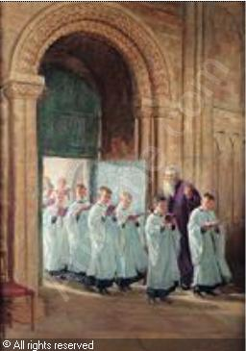
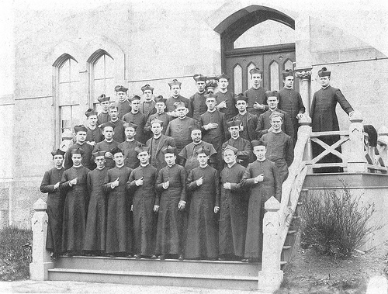
Historical Roots of Ushers
Porters - Doorkeepers
Minor Order “Porters”
Notes:
I thought it would be good to provide a little of the history of Ushers
In the Middle ages, the porter held the keys to the church doors and rang the bell to announce the start of mass. He also prepared the sacristy and helped keep order, letting in worshippers and keeping troublemakers out.
This became more special and ritualized in the early 1900’s when the Bishop would preside over a solemn ceremony of the handing on of the keys and the responsibility that went with that.
This evolved into a minor order Porter on the way to ordination to the priesthood. So, in time the only porters were young men studying for the priesthood. In 1972 Pope Paul VI discontinued this practice. Now men and women of any age can and SHOULD be ushers.

Slide 7
Hospitality is Ministry
Ushers are NOT traffic cops helping people move safely and
quickly to the right spot.
They are hosts who put a face onto the parish. They welcome those who arrive and begin the process of forming them as a worshiping body.
Notes:
HOSPITALITY IS MINISTRY – AND A CRITICAL COMPONENT OF YOUR PARISH’S EVANGELIZATION EFFORTS
All who enter should feel the sense of Christian welcome. Your ministry is to the entire community. If you only greet your friends or people you know, you segment the Body of Christ. But when you hold the door for everyone, you make each worshipper feel part of the whole body. When you greet even those you do not know, you show the concern Christ has for each member of the flock. When you learn the names of those who come to church, you strengthen the bond among the Faithful. And when you introduce people to each other, you weave the fabric of a strong celebration.
When people have begun forming the community before the start of Mass, they are better prepared to join in the community's activities of singing, speaking, listening, and observing silence together. Better prepared to participate in our community worship – the Mass.

Slide 8
Questions
Call or Email me at jwackerly@dio.org
Participation
When Do I Genuflect? When Do I Bow?
Notes:
Questions? Call or email me.
Participation – this is sometimes difficult as you may be called to assist latecomers. Generally, wait till the First Reading before you take your seat.
Be prepared for dismissal and send people off as you greeted them, with eye contact and a smile even if it’s behind a mask. This is your opportunity to model “Go in peace to prepare the way of the Lord.”
One thing I’ve been teaching our students is proper behavior in Church. You can help.
Before mass genuflect, honor is to the tabernacle. When you cross in front of the tabernacle genuflect, unless you are a Deacon with bad knees, then bow.
During mass a profound bow is made lean forward about 30 degrees toward the Altar is made. Honor is to the Altar, where the sacrifice of the Mass takes place.

Slide 9
St. Ambrose Usher Prayer
+ God, I stand at the door to welcome those You bring this way.
I come prepared to serve You, knowing I see Jesus in the faces of those I greet.
Prepare me this hour to:
Greet the Stranger with grace and warmth, for You know the pain of rejection;
Receive the Single Person, for You know the trials of a solitary life;
Encourage the Church Family, for You know the refreshment that fellowship brings.
Embrace the Children, for You loved them in all their ways.
Grant me Your spirit of hospitality, for those I serve may be Angels in disguise.
Let us go forward to serve the Lord and one another, + Amen.
Notes:
+
“Go in peace to prepare the way of the Lord.”

